Slide 1

introduction to Data science
Chris Qi
Ph.D. University of Maryland

Slide 2
Overview

Slide 3


Slide 4


Slide 5


Slide 6
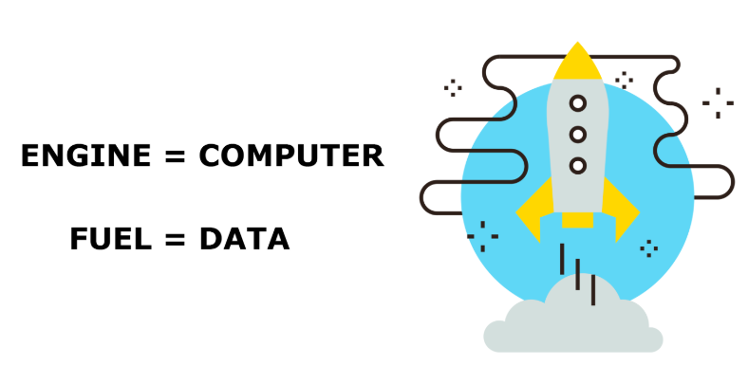

Slide 7
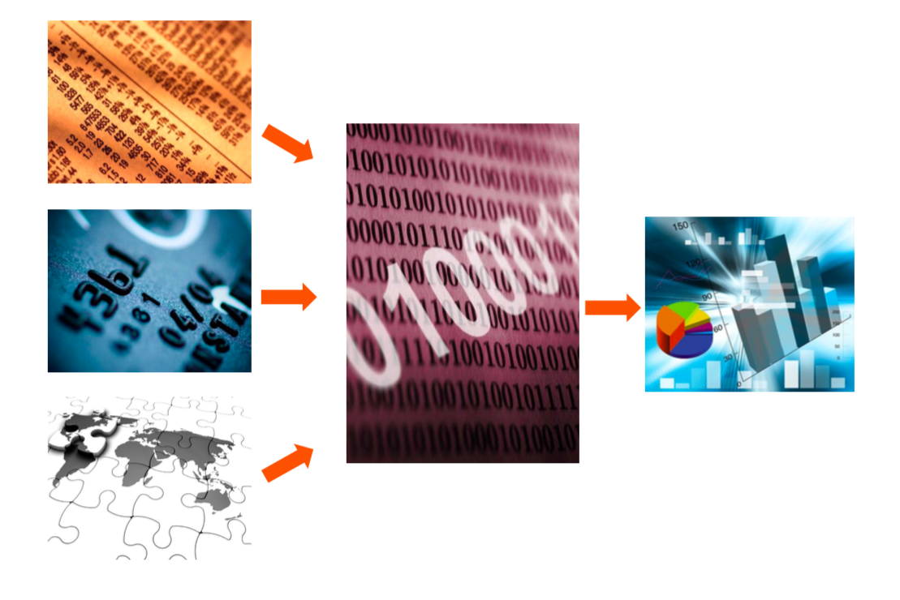

Slide 8
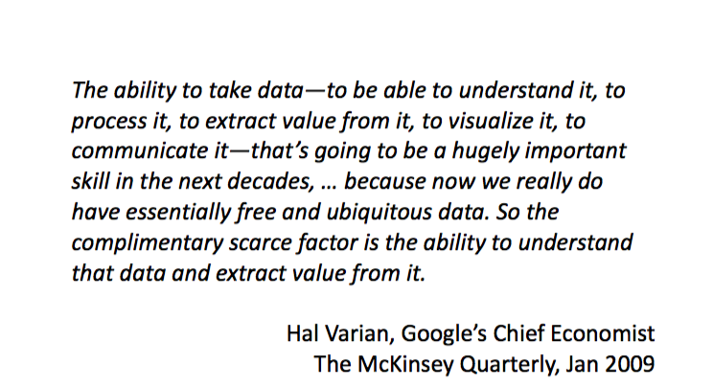

Slide 9
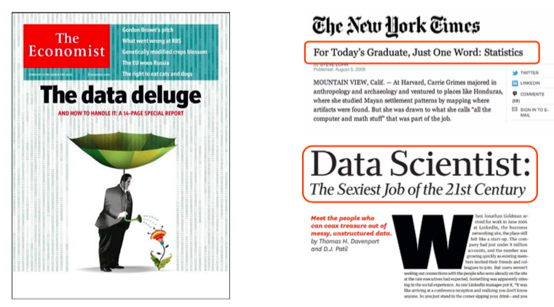
Notes:
Harvard Business Review

Slide 10
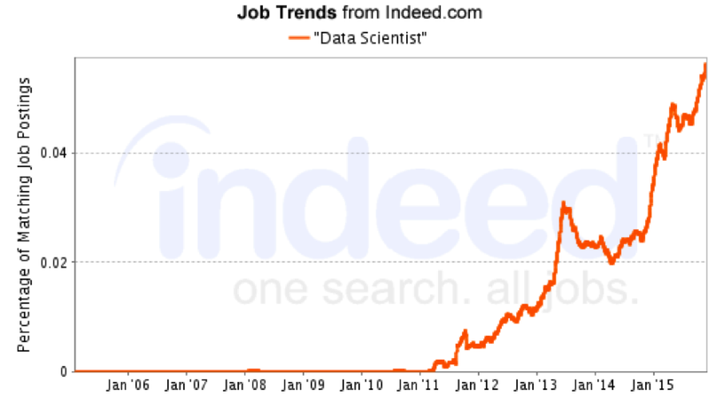

Slide 11
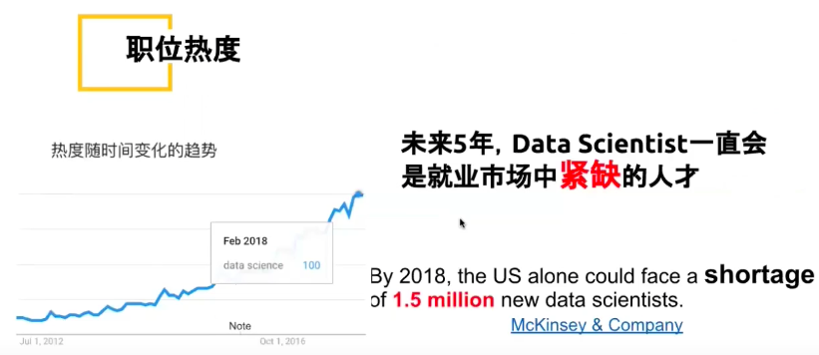

Slide 12
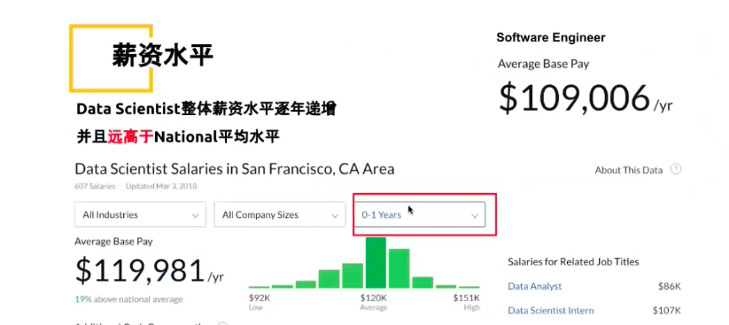

Slide 13
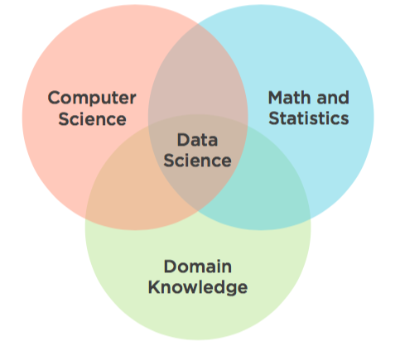
what is data science

Slide 14
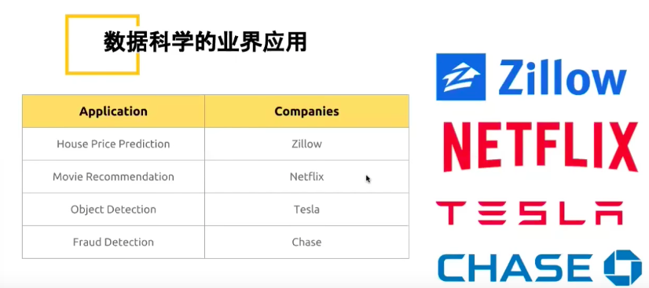
Applications

Slide 15
Prerequisites
Basic programming experience
Basic statistics experience

Slide 16
Data Science Skills
Programming
Working with data
Descriptive statistics
Data visualization
Statistical modeling
Machine learning

Slide 17
Why Is Data Science Important?
Internet of Things
Big Data
Machine learning
Fully autonomous systems

Slide 18
Why Is Data Science Important?
Driven by economy
Possible by technology
Cost is decreasing
Value is increasing

Slide 19
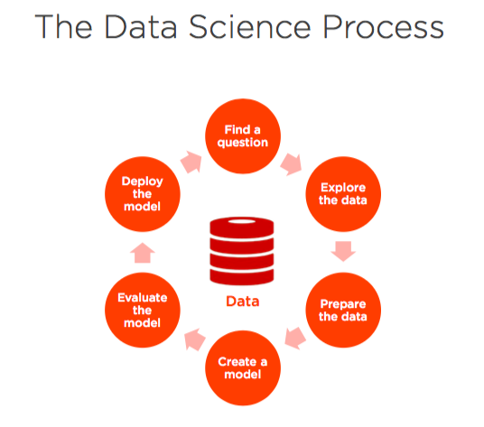

Slide 20
preview
Basic Statistics
R basic commands
Exploratory analysis
Data visualization
Linear Modeling
Prediction
Machine Learning

Slide 21

course objective

